Slide 1
Innovate with collaborative apps and low code
Notes:
Recommended sessions:
Power Pages and Power Apps Express Design: BRK42 - https://mybuild.microsoft.com/en-US/sessions/27e1a86d-b9d6-4440-84ad-a99b2084c7d9
Power Pages: ODBRK48 - https://mybuild.microsoft.com/en-US/sessions/12ae84f8-3038-43b4-b72a-015cd7807016
Power Automate RPA hosted bots: ODBRK46 - https://mybuild.microsoft.com/en-US/sessions/900959aa-8d7c-46aa-a1fa-e8bbd179ab71
I’m excited to be here to talk to you about the latest arrivals in our low code and no code technologies.

Slide 2

The impact of low-code
70%
of new applications in the enterprise will be developed with Low Code by 2025
“Power Apps is the undisputed market leader in low-code/no-code tools”
– Satya Nadella
Notes:
long time building the tech solutions of tomorrow has been an exclusive task, accessible only to those who know the secret language
But the world is changing , and LC/NC options are here and they're taking over.
Gartner predicts that 70% of apps inside of companies .... over the next 3 years.
It's already happening, with the number of LC solutions , including many external facing Portals on Power Platform, skyrocket millions.
Satya shared FY - Power Apps clear leader in LC/NC
But who's making these apps? Is it only novices or citizen developers?
No, business experts work pro developers, utilising low code technology to collaborate to innovate faster.
We can see the impact this has from one great Aussie example, Hearing Australia, Largest govt provide audiology. They serve all kinds of communities; especially the Aboriginal community where there is high incidents of early childhood hearing loss.
Bringing tech experts and audilogiy experts …. Power Apps.... many kinds of data together .... used offline on the go in communities throughout regional Australia.
147 locations & 2,000 patients every week
So let's take a look at our first piece of tech

Slide 3
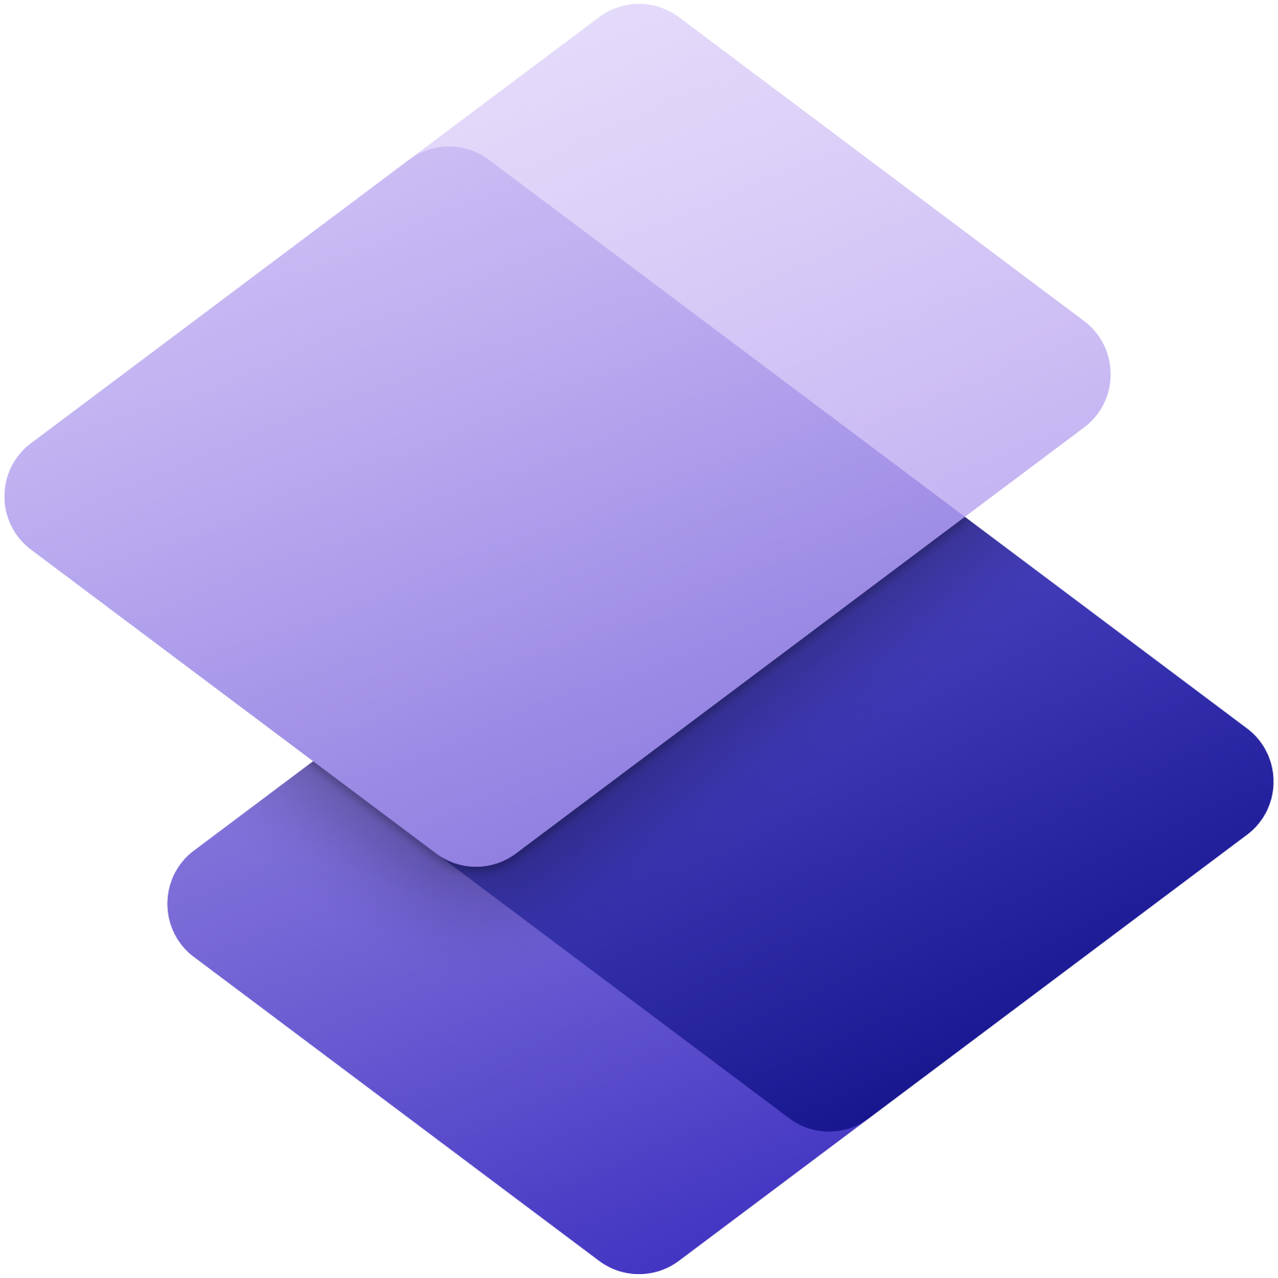
HIGHLIGHT 1
Power Pages
Preview
Notes:
So first up, is Power Pages
Low code platofrm, dev & host business centric websites
ALLOWS low code makers & pro devlopers to design, configure, and publish sites for desktop and mobile.
Previously, … feature in Power Apps called Power Apps portals. .....become fifth member of the Power Platform family.
I dev/build websites, but.... business/charity.
To keep growing you're stuck with the question of ditching your low code solution to go for something fully custom
So, I’m very excited about the options that Power Pages is offering, that means you can keep growing and building on, addding data too, and customising to whatever extent you want, on your web solution.
You can build that all on top of the low code app you start with.
So let's see what's in Power Pages the box!

Slide 4
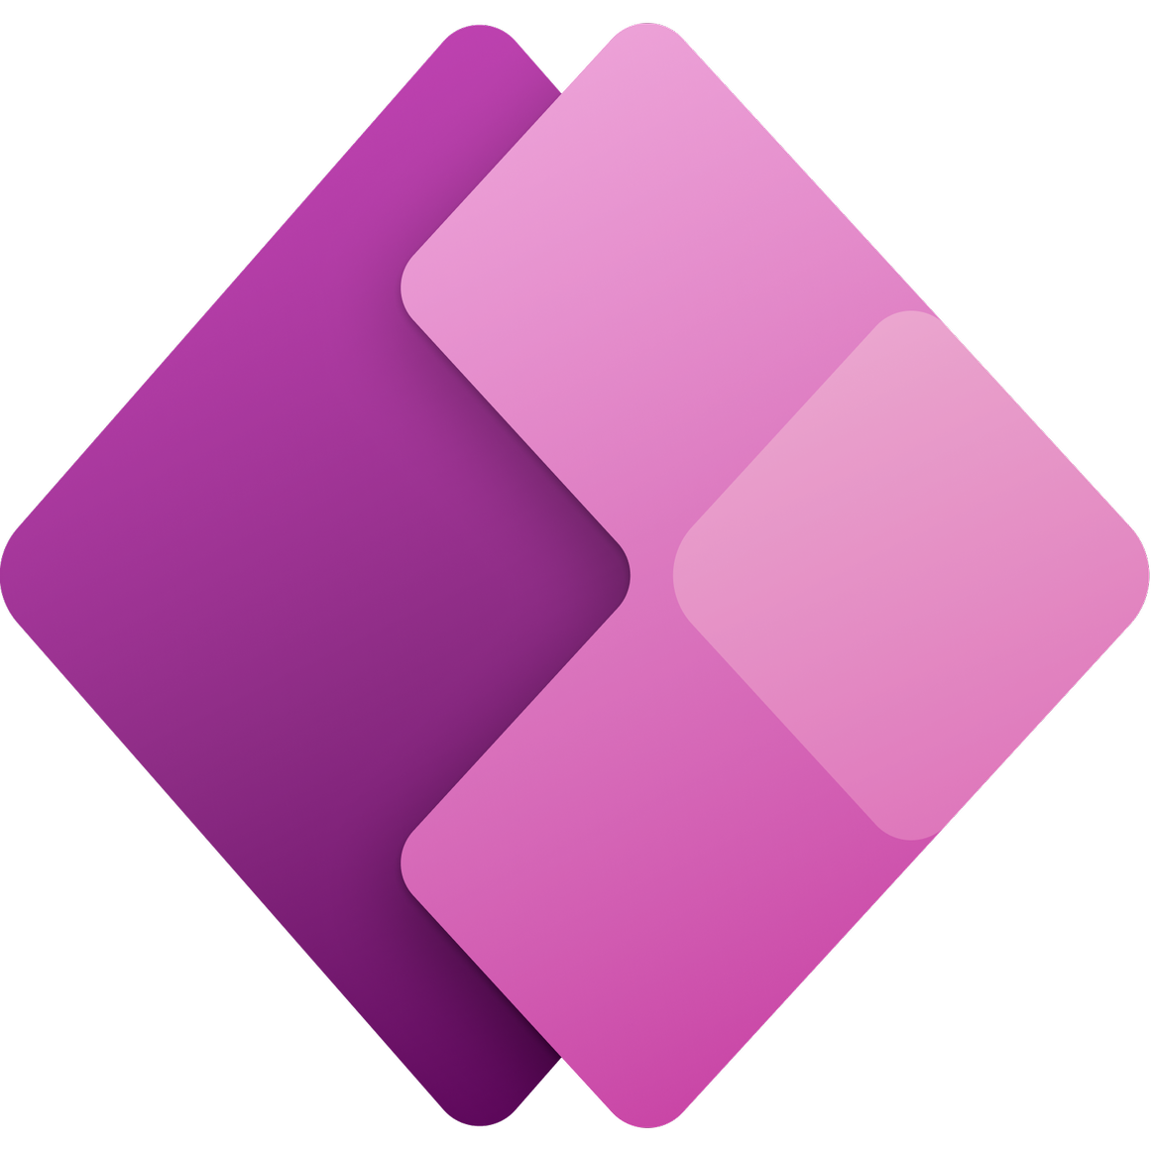



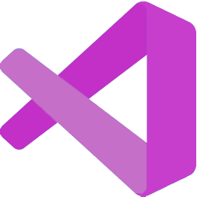


Power Pages capabilities
Low-code website development and business data modeling
Best in class pro-dev tooling to extend and customise
Robust and scalable enterprise- grade hosting platform
Better together
Build custom controls and CSS for design customisation or query business data
Enterprise-grade Application Lifecycle Management with Continuous Integration and Deployment
Notes:
So what do we get with Power Pages
Low-code Design Studio, create/style website, model/design business data forms/ lists. And utliise templates to jump start this whole process.
new level - custimisation you can use the pro-dev tooling, more coming
You also get a robust, scalable website hosting platform, with security and compliance build right into it.
And you can of course leverage the power of your other favourite microsoft tools, Website data with power BI, flows and bots with power automate , integrate power app , or virtual chat bot to your site with Power Virtual agents
### TRANSITION ###
So let's talk a bit more about customisation
With a VS Code extension you can
Download the entire Power Pages website content structured in YAML and HTML, limitless/use skill set.. pro devs.
Built-in support for Liquid language Intellisense (helping with code completion, assistance, syntax highlighting)
What can pro-devs do:
Build custom controls, like any of those you can see in the gallery of how to videos
Dynamically query business data through our data layer and APIs
Style your webpages with pixel perfect custom CSS
And we have enterprise grade Application Life Cycle management and Continuous integration and deployment with GitHub and Azure Dev Ops

Slide 5
Innovate with collaborative apps and low code
Notes:
Demo Video: 04-01 – Low Code – Power Pages.mp4
So let's take a look at the demo, and see some of the new and redesigned features for PP, now in preview.
Design studio, to build, style and publish your site,
We can design from scratch , or with a template from Templates hub, where you can get full-featured websites with demo data to create sites that manage scheduling, registration and app submission.
Learn hub, for tutorials and videos to learn how to build sites, model business data and work with code components.
Pro-Developer tools, we I mentioned, with integrations with Visual Studio, GitHub and Azure DevOps.
Security and Governance tools, to secure you website content and data, through role-based access controls and Azure.
Finally we have
Microsoft Dataverse, generally available, is a low code data platform that allows users to securely collect and share business information with site visitors.
As a dev, honestly my favourite thing is deleting code, and having the least code you need to get the results you want without losing flexibility, so I'm keen for Power Pages to handle all that boiler plate website stuff for me!

Slide 6
HIGHLIGHT 2
Power Apps express design
Preview
Notes:
So, onto our second highlight , Power Apps Express Design
I think this one speaks best for itself

Slide 7
Innovate with collaborative apps and low code
Notes:
Demo Video: 04-02 – Low Code – Express Design.mp4
No need to talk over this short video.

Slide 8
Innovate at speed with express design
Accelerate app development to get through a growing backlog and enable anyone to easily create a new app to scale development
Start from existing content such as a Figma design file, a PDF, a PPT file, a paper form, a screenshot of a legacy UI, or even a picture of your hand drawn app
Build an app within seconds by uploading your content and connecting to your data with over 600+ available connectors
Notes:
So I was super excited when I saw this!
I know as developers it's easy to get stuck in a land of code, but in reality …. someone's head, .... piece of paper, ....design files.
Users simply upload a picture of a hand drawn app, or use a graphic design mockup from Figma, a PDF, PowerPoint, or even a screenshot of a legacy UI.
Power Apps then converts it into a working Power Apps app with a UI and data schema within seconds, which you can then customise!
This has a huge potential to not only make app development accessible to a whole new range of people, but also just cut down the time for all users they spend setting up the same kind of boiler plate stuff that any app has.

Slide 9
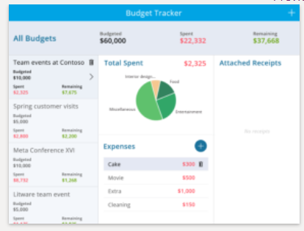

Using low-code AI to turn images into apps
Your image
Image to app wizard
Your app!
Tag your controls
Set up data
Azure Custom Vision
Object detection (identify controls)
Dataverse
Azure Computer Vision
OCR (text recognition)
Notes:
The Express design capability is now available to all Power Apps makers, and leverages Azure Cognitive Services object detection models.
Utilising azure's custom vision and computer vision tools to bring your vision to life.
We all know that humans are a very visual creatures, so it's amazing to be able to take that vision straight to implementation.

Slide 10
HIGHLIGHT 3
Power Automate hosted RPA bots
Preview
Notes:
Before this Build series I hadn't had much of a chance to check out robotic process automation (RPA).
So in preparing for this talk I got to look into what was already on offer, and then all the new stuff on top of that.
In learning about RPA I learnt how companies were already utilisng this technology
Make most of computing resources.... physical machines not in use by staff
Utlise flows, do mundane tasks
Eg: invoices, email, copy, action
The new offering in this space is the hosted RPA bots,
Not constrained by physical
Azure computing power on VMs.... bot workforce
Autoscaling, peak times (eg FY)
In addition to this, a new feature in preview is the Process Advisor integration, which allows you to leverage process analytics from different flows, to understand and manage your hosted RPA solution.
Let's take a look at one of the demos that's come out of build on how to set up your own hosted bots

Slide 11
Innovate with collaborative apps and low code
Notes:
Demo video: 04-03 0 Low Code – Hosted RPA bots.mp4
So here we're setting up a hosted bot machine group
We're calling our finance machines
Next up we need to select an image for these machines,
There's the default Windows desktop, which might have all the software options you need.
Or you might want a custom image with more software options.
Finally we put in our admin username and password
Our bots deploy in minutes and are ready to tackle our flow.
This flow is about responding to product requests
We set the flow to run unattended to get full scaleability
And set it to use our hosted bot finance machines
Now we can see the queue of tasks, the first 3 od which are being processed by the 3 bots.

Slide 12
Attended or unattended RPA scenarios
Attended
(aka Digital assistant)
Unattended
Automation launched under user’s supervision
Automation launched independent of any human involvement
Helps address tasks faster while still requiring human input
Tasks are fully automated and can be run at scale
Notes:
Let’s take a quick look at the difference between attended and unattended RPA.
Firstly, we have attended, aka a digital assistant. This is where we want some oversight or input by a human.
Maybe in our invoice example, we want our bots to line up all the payments but do want a human to give the OK before firing off that payment.
Conversely, you might have something you're happy for the bots to take care of you with no intervention, so it can run at full scale.
Maybe sending invoices

Slide 13
Hosted RPA bots key features
Streamlined and fast setup
Auto-scale based on the work queue content
Bots seamlessly load balanced across the different workloads
Notes:
With hosted RPA you can really scale up how you manage tasks, because
Hosted bots are available within minutes
Don't have to set up/manage individual machines
You also don't need to install or register Power Automate for Desktop. (like you would if deploying flows to your own physical machines)
Bots are easily assigned to different tasks.
Ultimately, hosted RPA bots bring more autonomy for automation services and citizen developers
… instant access resources .... run unattended automation at scale.
Stopping physical machines being your bottle neck in your business.

Slide 14
What’s next?
Power Pages https://docs.microsoft.com/power-pages/
Power Apps express design https://aka.ms/expressdesigndocs
Power Automate hosted RPA bots
https://aka.ms/hostedrpabotsdocs
Hearing Australia collaborates on Power Apps https://youtu.be/iZC1itZQ7L4
Notes:
If you have a Microsoft tenant (including ones listed as free) you can try out these features.
Check them out here.

